Slide 1

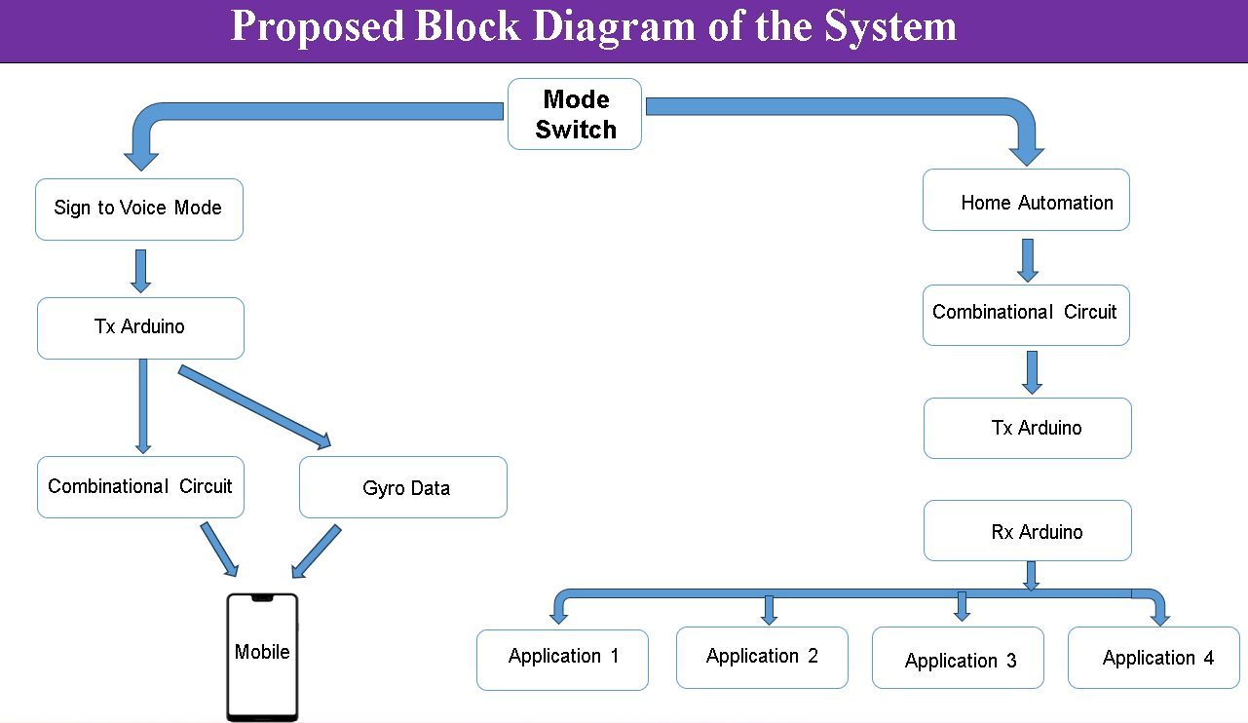
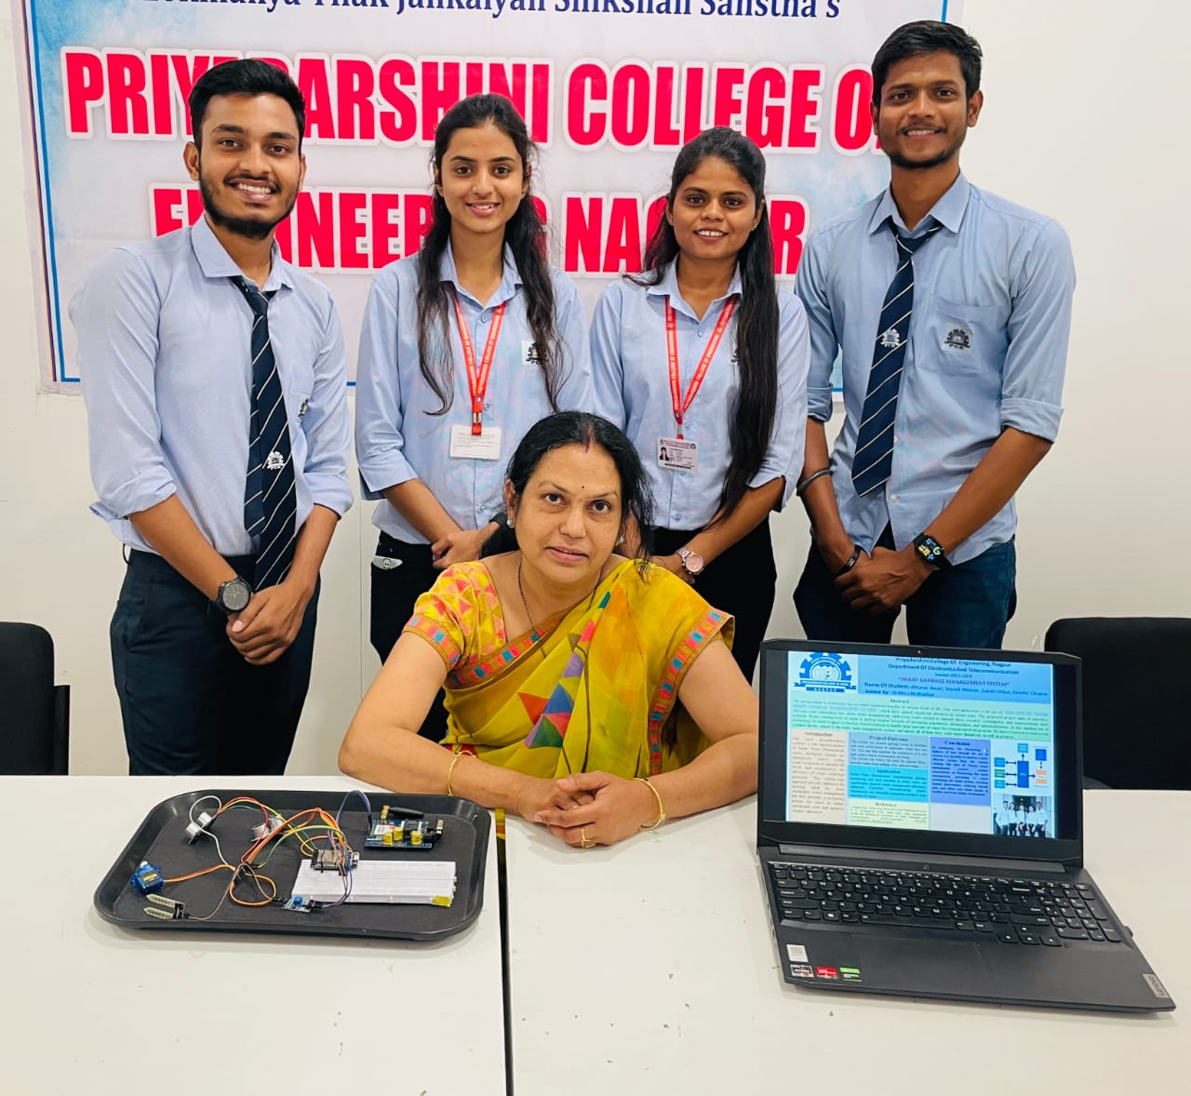
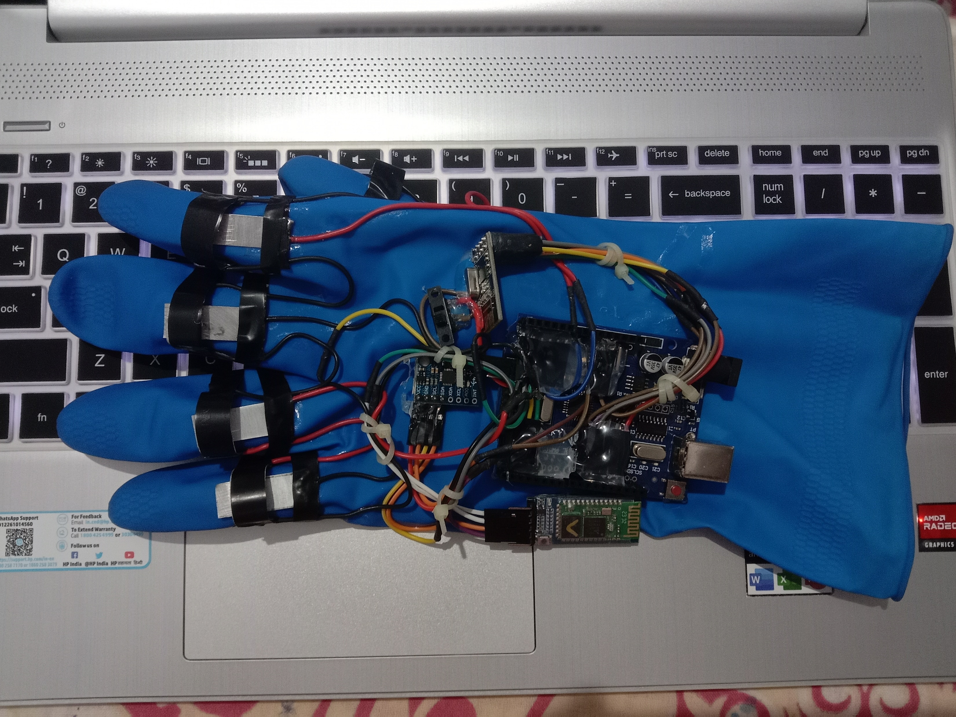
Block Diagram
Priyadarshini College Of Engineering, Nagpur
Department Of Electronics And Telecommunication
Session 2023-2024
“SMART GLOVE TO CONVERT GESTURES TO SPEECH”
Name Of Student :- Nayan Lende, Siddesh Yerawar, Ved Botkewar, Yash Ambildhuke
Guided By :- Mr. O.G. Hastak
Abstract
This project focuses on developing a Smart Glove that converts hand gestures into speech, enabling effective communication for individuals with paralysis or speech impairments. The glove integrates an ADXL345 accelerometer and Combinational Circuit to detect hand movements, with an Arduino Uno processing the data. Signals are transmitted via an NRF24L01 wireless module or Bluetooth HC-05 to a mobile application, which generates speech output. Designed to be affordable, portable, and user-friendly, this assistive device bridges the communication gap, particularly benefiting underprivileged areas. Future improvements may include machine learning-based gesture recognition and multi-language support for enhanced usability. Unlike costly existing solutions, this system offers an accessible and practical alternative, fostering social inclusion and improving the quality of life for individuals with disabilities.
Introduction Paralysis affects many. We're developing a smart glove that translates hand gestures into speech and controls home appliances, improving communication and independence. It also sends messages via a mobile app, using Arduino technology. This empowers users to live more autonomously. Ultimately, we aim to bridge communication gaps and enhance the quality of life for individuals with physical limitations.
Project Outcome
Improved communication and independence for paralyzed individuals through gesture-based speech and home control. Enhanced accessibility and mobile messaging capabilities using Arduino technology.
Conclusion
This project successfully addresses the communication and mobility challenges faced by paralyzed individuals through a smart glove that translates hand gestures into speech and controls home appliances. By offering an affordable and accessible alternative to expensive assistive devices, it promotes greater independence and inclusion. The integration of wireless communication and mobile support enhances usability, making it a practical solution for daily life.
Application
This system works using technologies. This application gives inputs from the user and processes it to find out the proper meaning. Then it gives responses in various formats through speaker and LCD
.
Project Model
Reference
Authors: Kshitij Kadam, Sakshi Telange, Krishna Yadav, Ashish Vishwakarma. Helping Hand : A Glove for Mute People. Published on: 14th April, 2023 At International Journal of Recent Technology and Innovations. (IJRTI)

